Slide 1

DBMS Course Project
Web Application Development : Online Doctor Appointment Booking System.

Slide 2
TABLE OF CONTENTS
TITLE
PAGE NO.
🠶 | Title Slide | 1
🠶 | Project Info | 3
🠶 | Problem Statement | 4
🠶 | Introduction | 5
🠶 | Software’s used and their purpose | 6
🠶 | Design pictures | 7
🠶 | ER Diagram | 9
🠶 | Features of Project | 10
🠶 | Details of Project Work | 11
🠶 | Project video | 12
🠶 | Resources used | 13
🠶 | Report | 14
🠶 | Conclusion | 15

Slide 3
PROJECT INFO
College Name
: S.G.G.S.I.E.T Vishnupuri, Nanded-431606
: BHUPESH MILIND BORKAR

Slide 4
PROBLEM STATEMENT
Problem Statement : As a result of the COVID-19 pandemic break and lockdown in many part of the country there is an urgent need to development of an online platform interface where patients can book appointment to their regular or local doctors for their previous long-term diseases, chronic diseases, acute diseases, and regular diagnoses. To directly seek diagnoses and treatment for problems like common cold, headaches, etc.
Problem Statement Solution : According to a recent survey, 43% of patients prefer to book appointments online, and 57% of consumers go online when searching for a new healthcare provider. Also, 72% of patients and 60% of healthcare professionals say online booking platforms encourage patients to keep appointments.
Suppose you are in the healthcare industry and seeking to improve the quality and productivity of your medical services. In that case, no doubt, developing a doctor's appointment app or a web platform might be the right solution for your practice. Many patients consider this kind of doctor-on-demand app essential for any healthcare provider now, regardless of whether they are getting treatment at a hospital, clinic, or private practice.

Slide 5
INTRODUCTION
As the name suggests online doctor appointment booking system this system basically helps doctors and patient to connect easily and book appointments over an online platform. This system provides separate work space for Doctors and Patients. This system helps the users to find a doctor with specific specialty in within walking distance. User can select a doctor and easily book an appointment with the help of appointment calendar which shows the booked and free slots of the doctor for a particular day. Using this system user can easily re-schedule an appointment as the suitable. This system provides a facility to add a name of a relative under same registration number. User can add a favorite doctor in his/her login whom he/she consults regularly. User gets notifications and reminders for the upcoming appointments.
The main purpose for building this system is to ease out the traffic maintenance the database of patients and doctors. This system helps the hospitals to manage the data digitally which is safe and secure. Doctors can easily find out their day to day appointments with patients using this system. Patients can know where to reach as soon as possible in emergency situation. This system allows the patients to rate a doctor using 5 star ratings.

Slide 6
SOFTWARE’S USED AND THEIR PURPOSE
Front end : HTML, CSS, Java, JavaScript
HTML: HTML is used to create and save web document. E.g. Notepad/Notepad++
CSS : (Cascading Style Sheets) Create attractive Layout
Bootstrap : responsive design mobile friendly site
JavaScript & Java : it is a programming language, commonly use with web browsers.
Back end: PHP, MySQL
PHP: Hypertext Preprocessor (PHP) is a technology that allows software developers to create dynamically generated web pages, in HTML, XML, or other document types, as per client request. PHP is open source software.
MySQL: MySQL is a database, widely used for accessing querying, updating, and
managing data in databases.

Slide 7
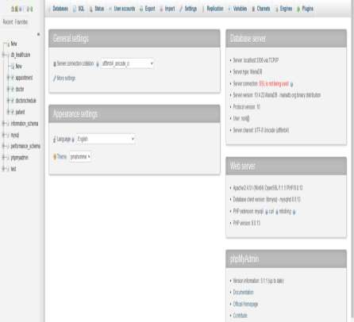
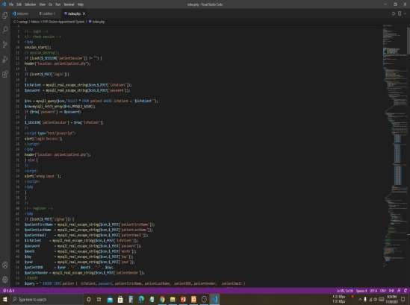
DESIGN PICTURES
Fig : PhP, Sql workbench ; vs code ; notepad ,etc.

Slide 8
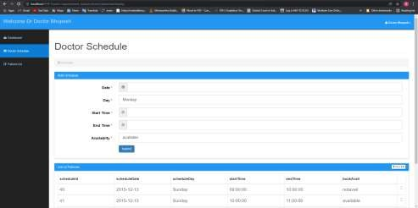
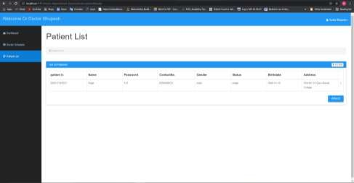
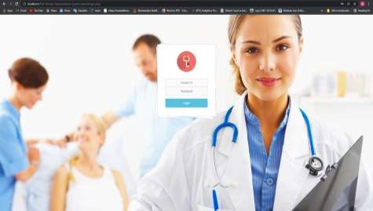
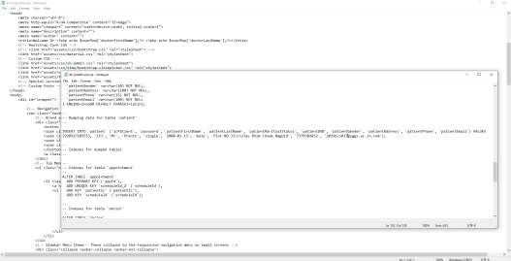
DESIGN PICTURES

Slide 9
ER DIAGRAM
Phone
address
name
address
Email
Name
Gender
Patient
Books appointment
Doctor
Email
icDoctor
DOB
MaritialStatus
DOB
icPatient

Slide 10
FEATURES OF PROJECT
The Online Doctor Appointment Booking System is a course project developed using PHP, MySQL, Java, bootstrap and CSS. The main features of this web application project are as follows :
The project contains an admin and user sides. The admin side manages all the management like managing schedules, patient records and manage the appointment time, manage treatment facilities, and so on.
This system allows us to directly book an appointment with doctors and
medical experts through online medium sitting in our homes.
This system is very effective in tackling the modern day problems during this
hard time of pandemic.
This system is easily accessible through any web platform and we can book
our appointments. We can directly message and consult the doctor.
Patient and Doctors details such as age, phone number, address, etc. are
available in the web application.
Both patients and doctors can create an account of their own and its easily accessible.

Slide 11
PROJECT VIDEO
Google Drive(2019bcs091@sggs.ac.in) video link :
https://drive.google.com/file/d/1QxDa_QCy3plm22Q0zQ5am5Nj- p2vfcTf/view?usp=sharing

Slide 12
RESOURCES USED
🠶 https://www.nbis.se/assets/img/logos/
🠶 https://zapier.com/blog/best-appointment-scheduling-apps/
🠶https://10to8.com/blog/how-to-create-an-online-booking-system-free- guide/
🠶 https://www.w3schools.com/php/
🠶 HTML/CSS: Making webpages
🠶 https://www.khanacademy.org/computing/computer-programming/html-
css
🠶 https://www.geeksforgeeks.org/css-tutorials/
🠶 https://www.softermii.com/blog/doctor-appointment-app-development-
guide-features-technologies-and-monetization

Slide 13
REPORT
The proposed project is a smart appointment booking system that provides patients or any user an easy way of booking a doctor’s appointment online. This is a web based application that overcomes the issue of managing and booking appointments according to user’s choice or demands. The task sometimes becomes very tedious for the compounder or doctor himself in manually allotting appointments for the users as per their availability. Hence this project offers an effective solution where users can view various booking slots available and select the preferred date and time. The already booked space will be marked and will not be available for anyone else for the specified time. This system also allows users to cancel their booking anytime. The application uses HTML, CSS, Java, JavaScript as a front-end and SQL database as the back-end.

Slide 14
CONCLUSION AND SUMMARY
As per requirements of the DBMS course project I have finished building a high-end web application . The online doctor appointment booking system is a working web application project which can be used by hospitals, doctors, patients and common people for their benefit.
I have developed an interface where doctors and patients in need for doctor can connect with each other and book their appointment beforehand without visiting the hospital or clinic physically.
The project contains an admin and user sides. The admin side manages all the management like managing schedules, patient records and manage the appointment time, manage treatment facilities, and so on.

Slide 15
THANK
YOU!!!

